Slide 1

Objective
To correctly classify first generation Pokemons’ name based on the image.

Slide 2
Who’s that Pokémon?
Melissa Jacob
Jonathan Lin

Slide 3
Dataset
Objective: Identify Pokémon from images
Used existing Pokémon dataset from Kaggle
7000 samples of 140 different Pokémon
Modified the dataset due to limited resources
Used only 646 samples of 14 Pokémon
Chose 14 visually distinct Pokémon
Input features
4800 HSV values for 40x40 pixel image
Target: 1 of 14 Pokémon

Slide 4
Data Preprocessing
Scaled images to 40x40 pixels
Standardized into HSV format
Split 80% training 20% testing
Stratified split to maintain all targets
Normalized with standard scaler

Slide 5
Logistic Regression
Tested with:
No penalty
L1 penalty
L2 penalty
L1 and L2 penalty tested with:
C = [0.00001,0.0001,0.001,0.01,0.1,1,10,100]
Image transformations:
None
Vertical flip
Rotation
Brighten

Slide 6
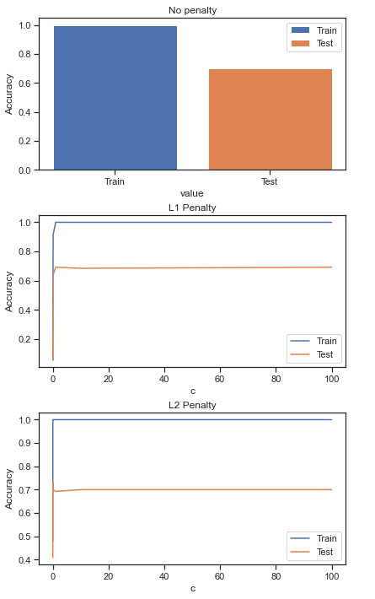
Logistic Regression
No transform
Transformations didn’t have a significant effect
Winner: L2 regularization with c=0.001 (λ=1000)
Accuracy = 73%
Weighted average precision = 77%

Slide 7
SVM
Tested with:
Linear kernel
Polynomial kernel (degree=3)
RBF kernel
L2 penalty
C = [0.00001,0.0001,0.001,0.01,0.1,1,10,100]

Slide 8
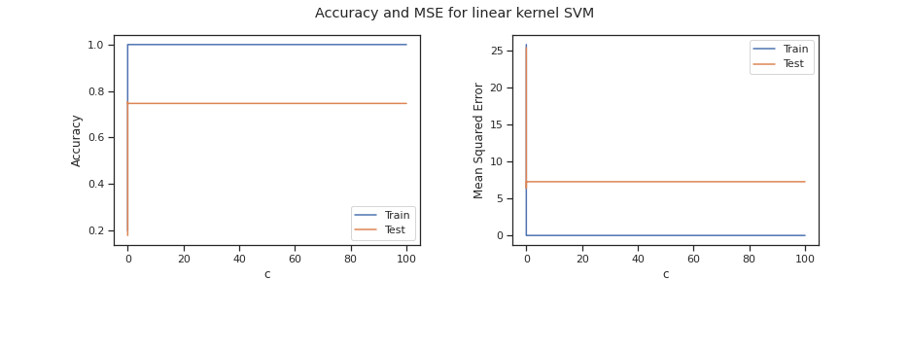
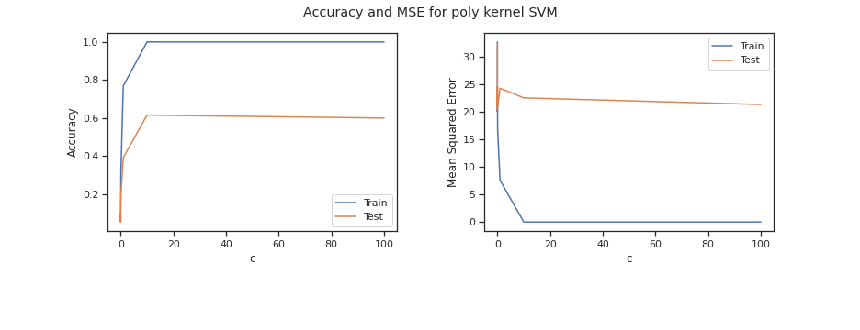
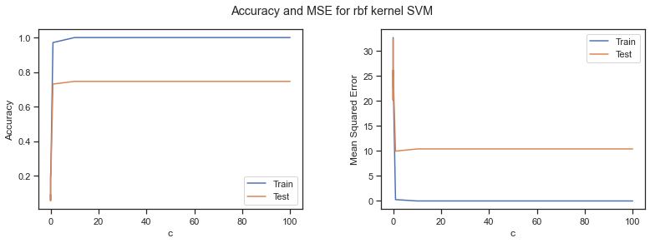
SVM
Winner: RBF kernel with c= 10 (λ=0.1)
Accuracy = 75%
Weighted average precision = 77%
Linear Kernel
Polynomial Kernel
RBF Kernel

Slide 9
Neural Network
MLP Classifier
Tested with:
Logistic (sigmoid)
ReLU
Tanh
1 and 2 hidden layers

Slide 10
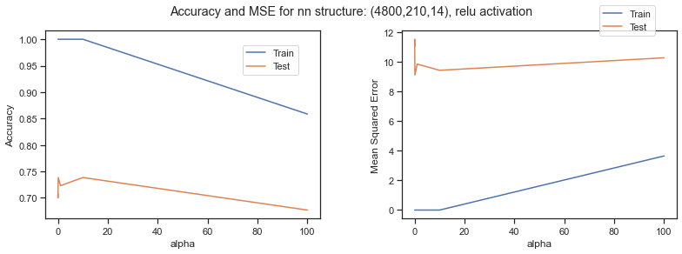
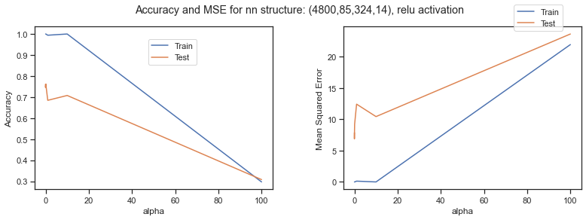
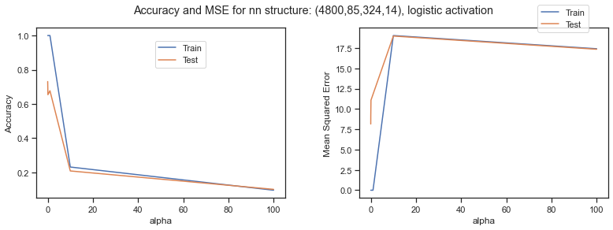
Neural Network
Winner: Two hidden layers with ReLU activation function and alpha = 0.1 and
Accuracy = 76%
Weighted average precision = 78%
1 hidden layer, ReLU
2 hidden layers, ReLU
2 hidden layers, logistic

Slide 11
Result
Overall Winner:
Neural network with to hidden layers, ReLU activation function, and alpha = 0.1 and
Accuracy = 76%
Weighted average precision = 78%
All other models had around 70-75% testing accuracy and 95-100% training accuracy

Slide 12
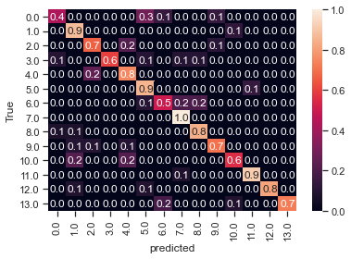
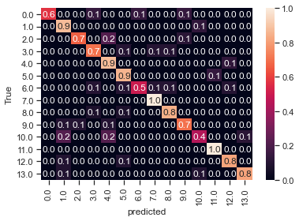
Why so low?
Best Logreg (RBF similar)
Best Neural Network

Slide 13
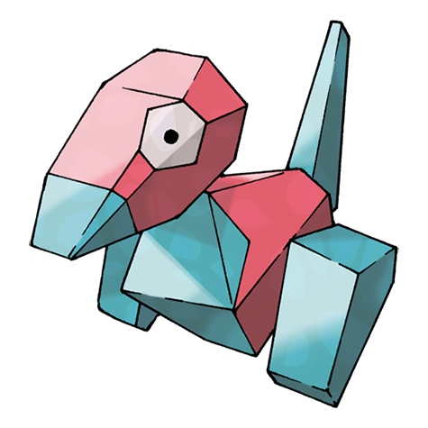
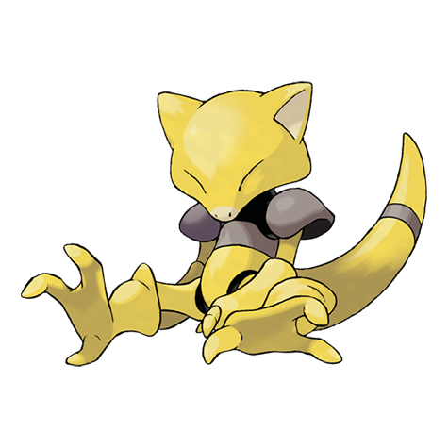
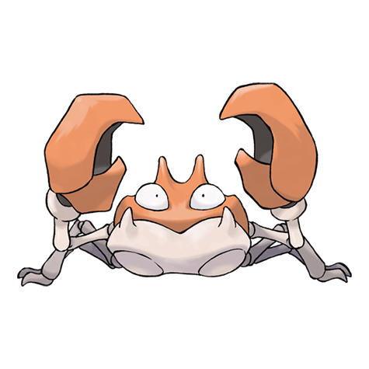
It’s their fault
Notes:
It’s possible that these pokemon were not distinct enough from each other to be properly classified with the image resolution and number of training samples we used.

Slide 14

Is this a pikachu?

Slide 15
Conclusion
Successfully utilized all methods learned in class
Image classification/recognition is harder to do than expected.
Possible improvements:
Increase sample size per class
Increase resolution
Increase max number of iterations
Future works:
Try CNN for image classification

Slide 16



